Slide 1
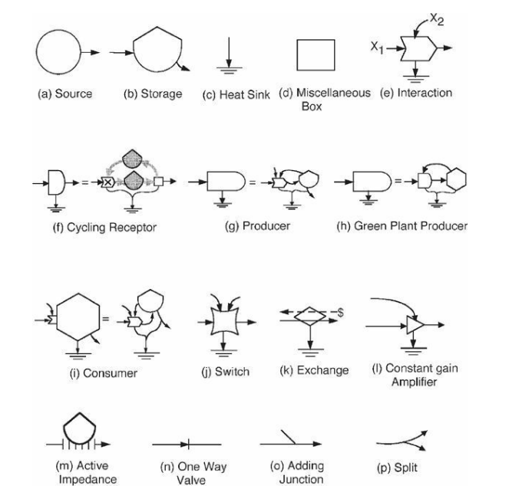
Odum Flowchart Symbols

Slide 2
hv
Wheat
PMillet
C3
C4
hv
W-UK
Pmillet - S
C3
C4
hv
W-IR
Pmillet - T
C3
C4

